Slide 1
1

Slide 2
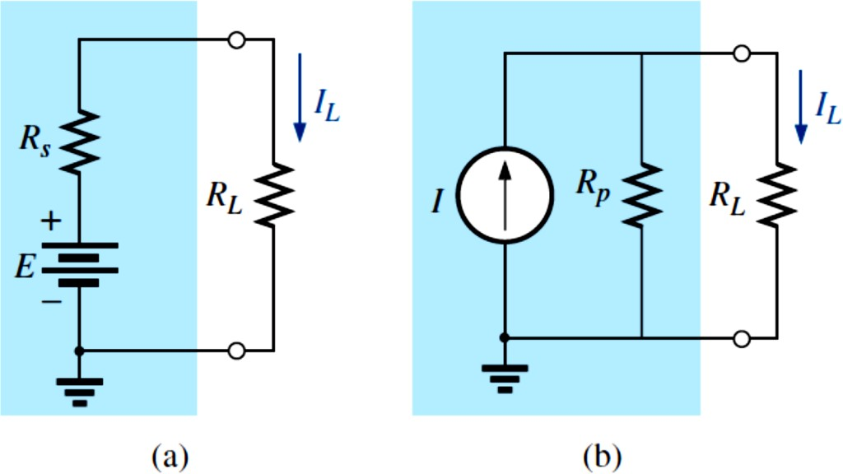
2
3 – 1 Source Conversions
The current source appearing is the previous section is called an ideal source due to the absence of any internal resistance. In reality, all
sources—whether they are voltage sources or current sources—have some internal resistance in the relative positions shown in Fig. 1. For the
voltage source, if 𝑅_{𝑠} = 0Ω , or if it is so small compared to any series resistors that it can be ignored, then we have an “ideal” voltage source for all practical purposes. For the current source, since the resistor R_{P} is in
parallel, if 𝑅_{𝑃} = ∞ Ω, or if it is large enough compared to any parallel
resistive elements that it can be ignored, then we have an “ideal” current source.
Fig. 1
Practical sources: (a) voltage; (b) current.
Unfortunately, however, ideal sources cannot be converted from one type to another. That is, a voltage source cannot be converted to a current source, and vice versa—the internal resistance must be present. If the voltage source in Fig. 1(a) is to be equivalent to the source in Fig. 1(b), any load connected to the sources such as R_{L} should receive the same current, voltage, and power from each configuration. In other words, if

Slide 3
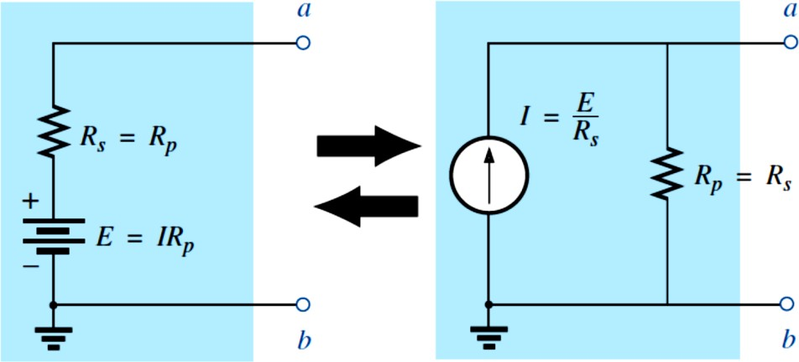
3
the source were enclosed in a container, the load R_{L} would not know which source it was connected to.
This type of equivalence is established using the equations appearing in
Fig. 2 First note that the resistance is the same in each configuration— a nice advantage. For the voltage source equivalent, the voltage is determined by a simple application of Ohm’s law to the current source:
𝑉 = 𝐼𝑅_{𝑃}. For the current source equivalent, the current is again determined by applying Ohm’s law to the voltage source: 𝐼 = 𝑉/𝑅_{𝑠}. At first glance, it all seems too simple, but Example 1 verifies the results.
Fig. 2
Source conversion
It is important to realize, however, that
the equivalence between a current source and a voltage source exists only at their external terminals.
The internal characteristics of each are quite different.

Slide 4
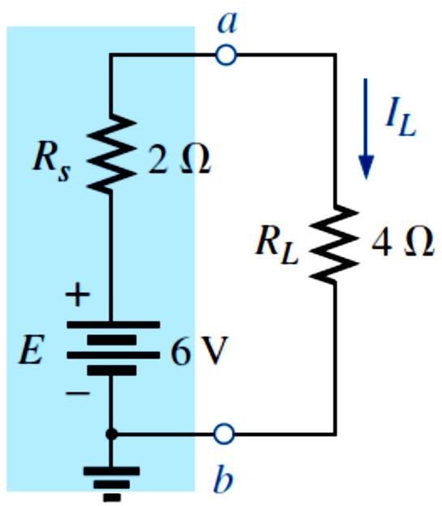
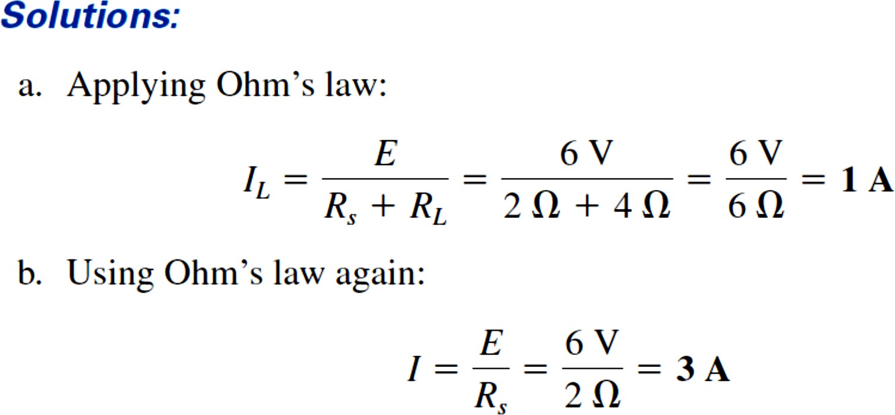
4
EXAMPLE.1 For the circuit in Fig. 3:
Determine the current I_{L}.
Convert the voltage source to a current source.
Using the resulting current source of part (b), calculate the current through the load resistor, and compare your answer to the result of part (a).
Fig. 3
and the equivalent source appears in Fig. 4 with the load reapplied.

Slide 5
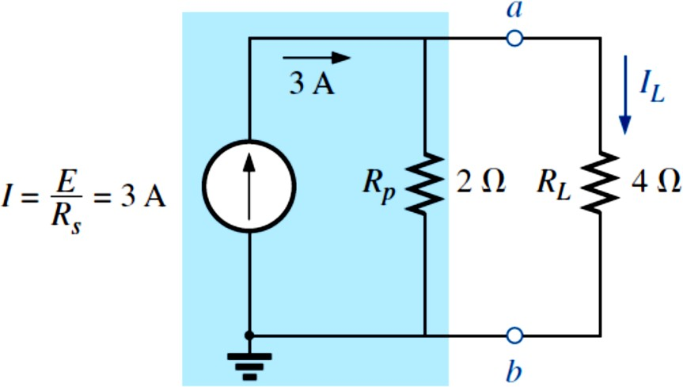
5
As demonstrated in Fig. 1 and in Example 1, note that
a source and its equivalent will establish current in the same direction through the applied load.
In Example 1, note that both sources pressure or establish current up through the circuit to establish the same direction for the load current I_{L} and the same polarity for the voltage V_{L}.

Slide 6
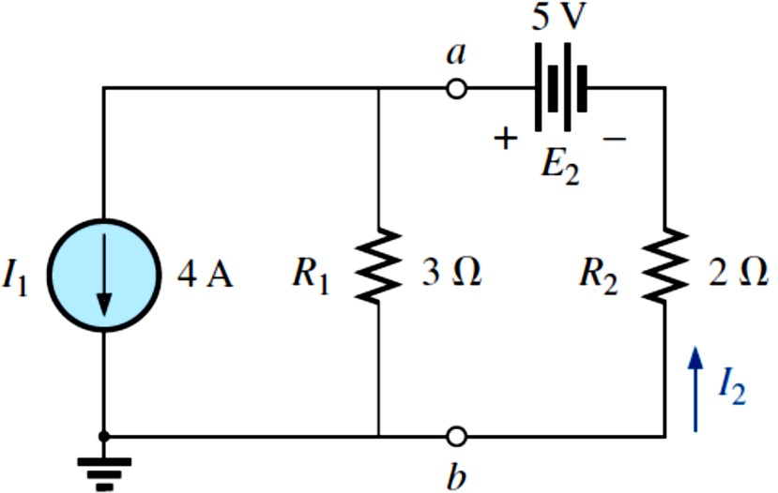
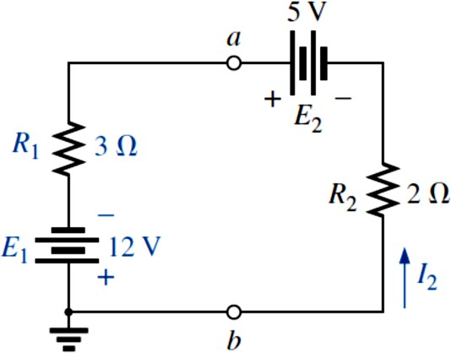
6
EXAMPLE 2 Determine current I₂ for the network in Fig. 5
Fig. 5
Solution: Although it may appear that the network cannot be solved using methods introduced thus far, one source conversion, as shown in Fig. 6, results in a simple series circuit. It does not make sense to convert the voltage source to a current source because you would lose the current I₂ in the redrawn network. Note the polarity for the equivalent voltage source as determined by the current source. For the source conversion:
Fig 3.6

Slide 7
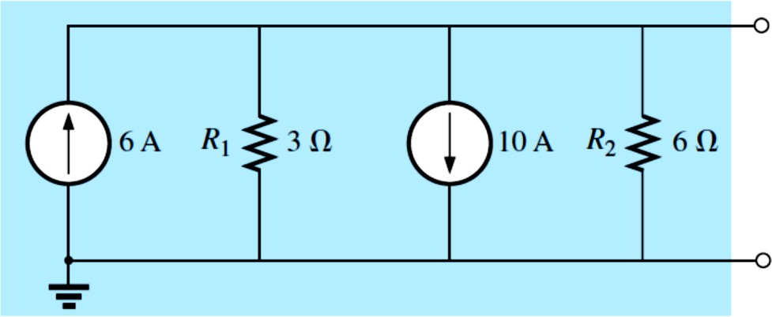
7
3 – 2 Current Sources in Parallel
We found that voltage sources of different terminal voltages cannot be placed in parallel because of a violation of Kirchhoff’s voltage law.
Similarly,
Current sources of different values cannot be placed in series due to a violation of Kirchhoff’s current law.
However, current sources can be placed in parallel just as voltage sources can be placed in series. In general,
Two or more current sources in parallel can be replaced by a single
current source having a magnitude determined by the difference of the sum of the currents in one direction and the sum in the opposite
direction. The new parallel internal resistance is the total resistance of the resulting parallel resistive elements.
Consider the following examples.
EXAMPLE 3 Reduce the parallel current sources in Fig. 7 to a single current source.
Fig. 7

Slide 8
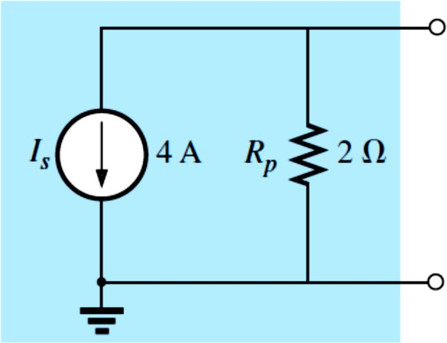
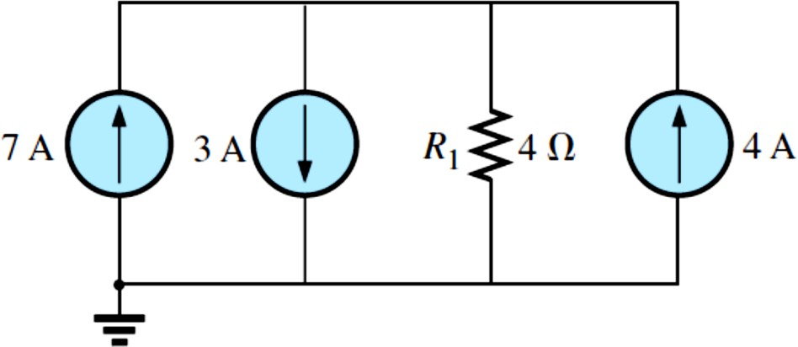
8
The reduced equivalent appears in Fig. 8.
Fig. 8
H.W. Reduce the parallel current sources in Fig. 9 to a single current source.
Fig. 9

Slide 9
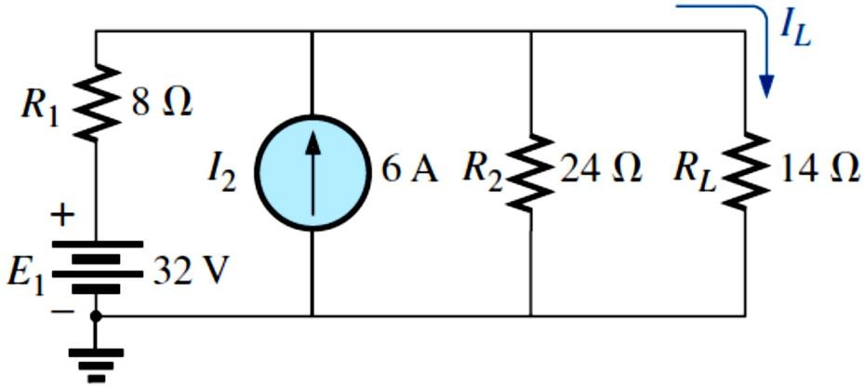
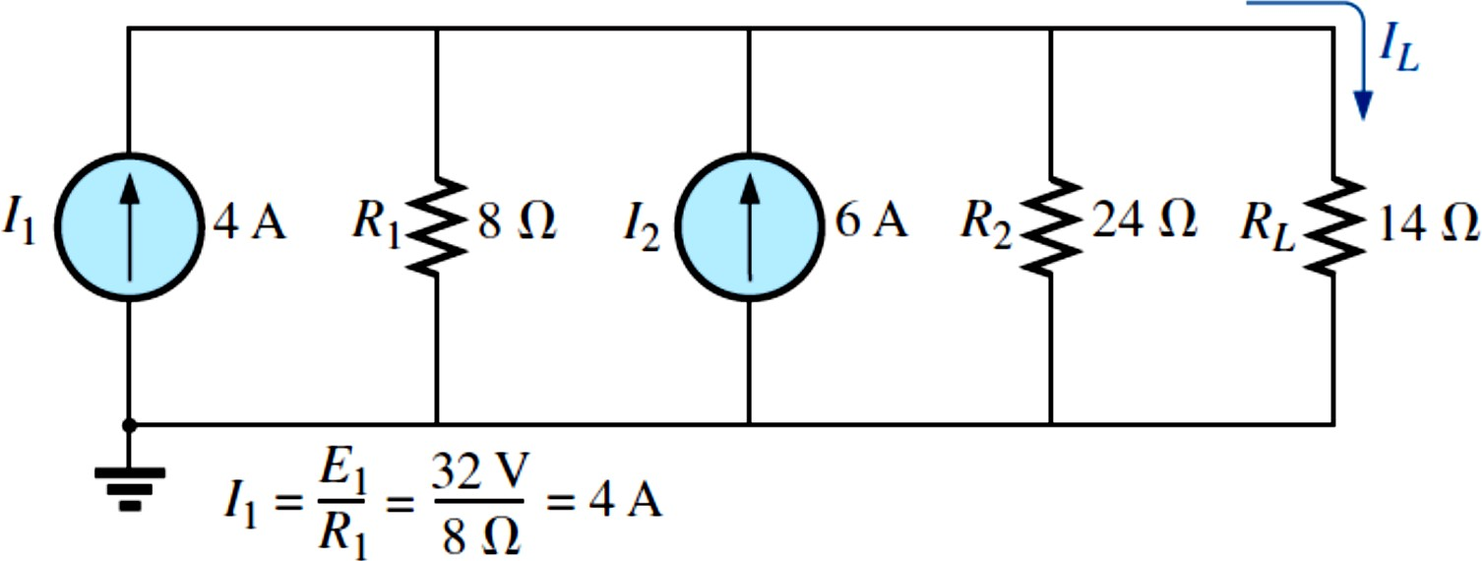
9
EXAMPLE 4 Reduce the network in Fig. 10 to a single current source, and calculate the current through R_{L} .
Fig. 10
Solution: In this example, the voltage source will first be converted to a current source as shown in Fig. 11. Combining current sources,
Fig. 11
Applying the current divider rule to the resulting network in Fig. 12,

Slide 10
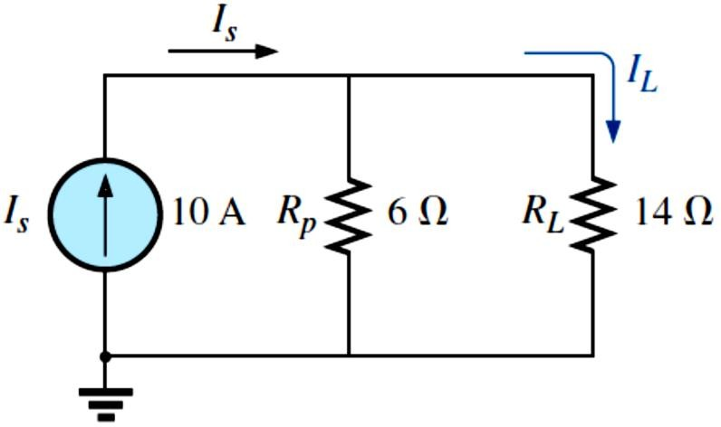
10
Fig. 12

